Slide 1
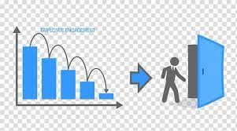
Employee Retention
Data Analyst Project 01
Group # 4
Team members –
1.Miss.Shweta Bhagwat Jadhav
2.Miss. Vaishali Jayawantrao Salunkhe
3. Mr. SHIVANANDA R
4. Mr. Gurunath Mahadev Swami
5. Mr. Swapnil Sandeep Joshi
6. Mr. Ravi Khodakiya
7.Sikandar kwr

Slide 2
Problem Statement:
Average attrition rate for all Departments
Average hourly rate of Male Research Scientist
Attrition rate Vs Monthly Income stats
Average working years for each Department
Job role Vs Work life balance
Attrition rate Vs Years Since last promotion

Slide 3
Business Objective:
The aim of this project is to analyze employee retention and attrition rates with the organization and provide insights to the HR team for developing effective retention strategies. Through data analysis and visualizations, we will identify factors that contribute to :
Employee turnover and attrition.
Evaluate the effectiveness of existing retention strategies.
To verify the satisfaction level of employee in the organization.
Provide recommendations to improve employee retention.

Slide 4
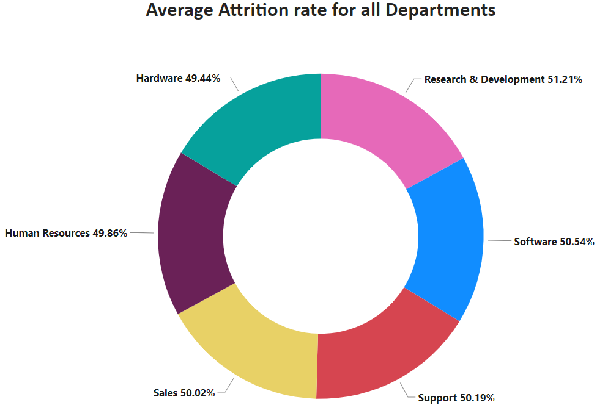
KPI 1 Average Attrition Rate for all Departments
This KPI is to find out the relationship between each department and its attrition rate and here attrition rate is highest for Research & Development Department whereas lowest is for Hardware Department.

Slide 5
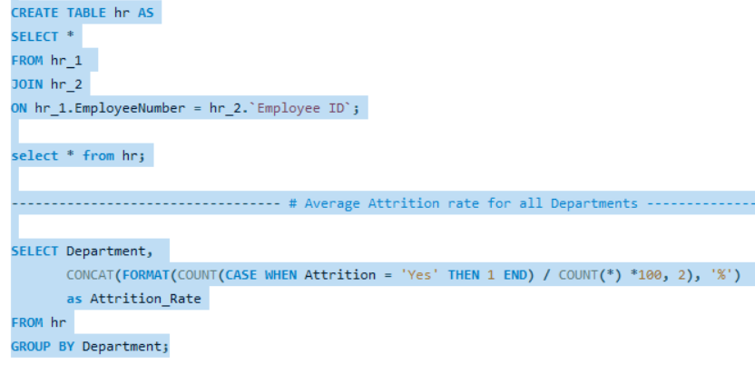
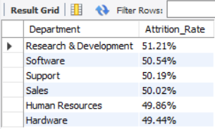
Insights from KPI 1:

Slide 6
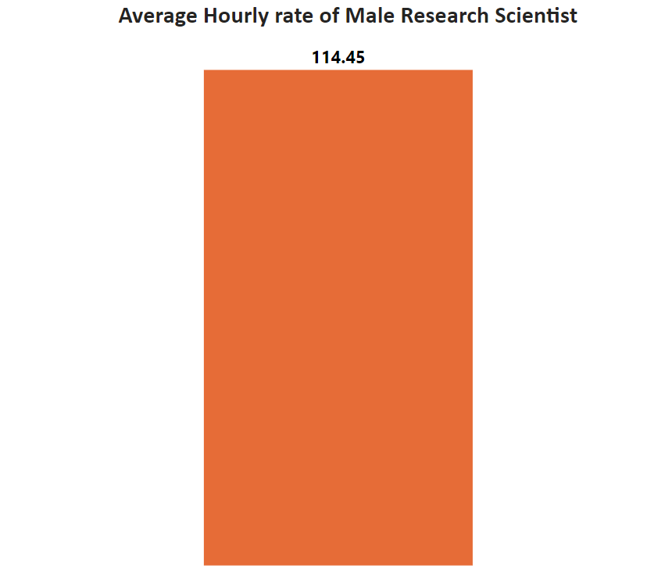
KPI 2 Average Hourly Rate of Male research Scientist :
Insights from KPI 2 :
This KPI is to find out the average hourly rate of male research scientists which is 114.45.

Slide 7
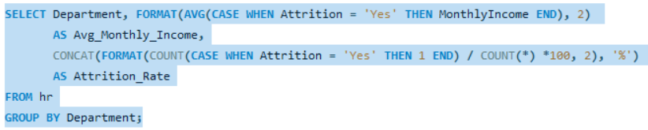
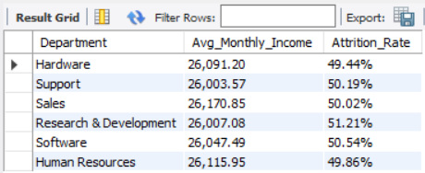
KPI 3 Attrition Rate vs Monthly Income Stats
This KPI is to find out the relation the between monthly income and Attrition rate.
Based on our analysis and visualization, it is evident that the Hardware Department has the lowest attrition rate of 49.44%, with an average monthly income of Rs. 26,091.20. On the other hand, the Research and Development Department has the highest attrition rate of 51.21%, with an average monthly income of Rs. 26,007.08

Slide 8
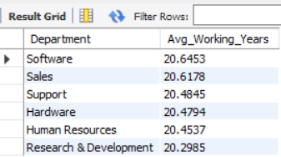
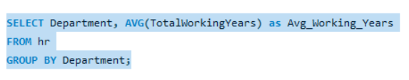
KPI 4 Average Working Years for each Department
From this we can see the average working years in software department is high as compared to the rest of the departments and lowest is for Research & Development Department.
From the analysis we can conclude that average working years is approximately 20 for all the departments.

Slide 9
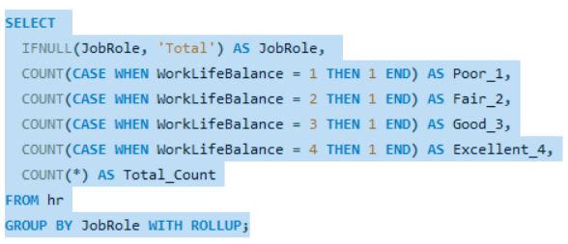
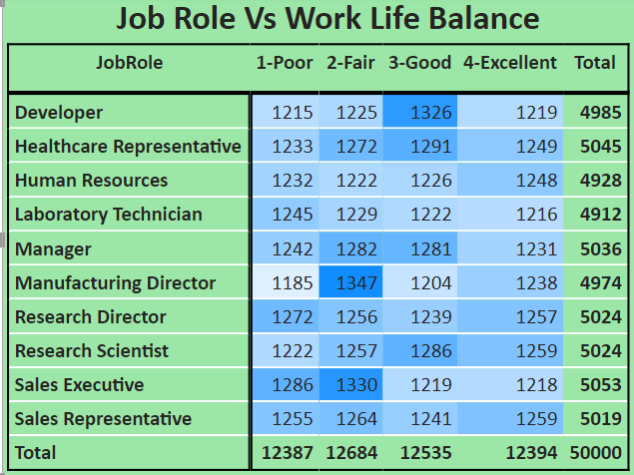
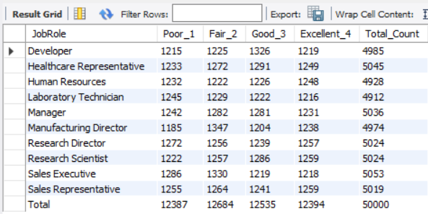
KPI 5 Job Role vs Work Life Balance for Total Employees

Slide 10
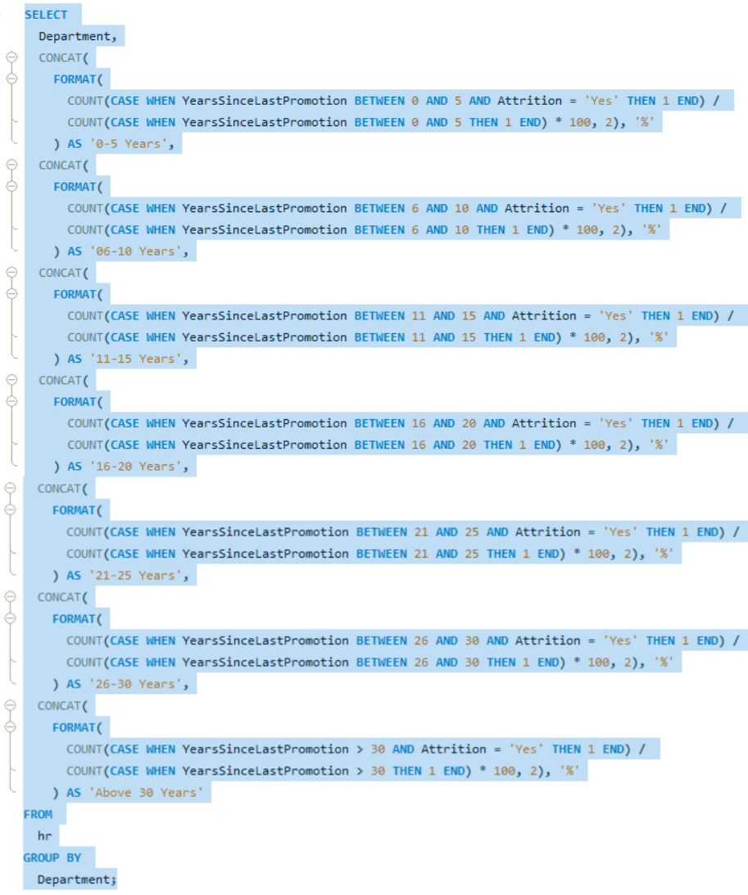
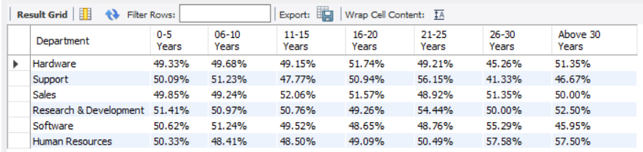
KPI 6 Attrition Rate Vs Years Since Last Promotion
From the analysis and Visualisation
For 0-5 years since Last year Promotion interval Research & Development and Hardware departments has highest and lowest attrition rate respectively.
For 6-10 years since last year promotion interval Human resources and software departments has highest and lowest attrition rate respectively.
For 11-15 years since last promotion interval support and sales departments has highest and lowest attrition rate respectively.
For 16-20 years since last promotion interval software & hardware departments has highest and lowest attrition respectively.

Slide 11
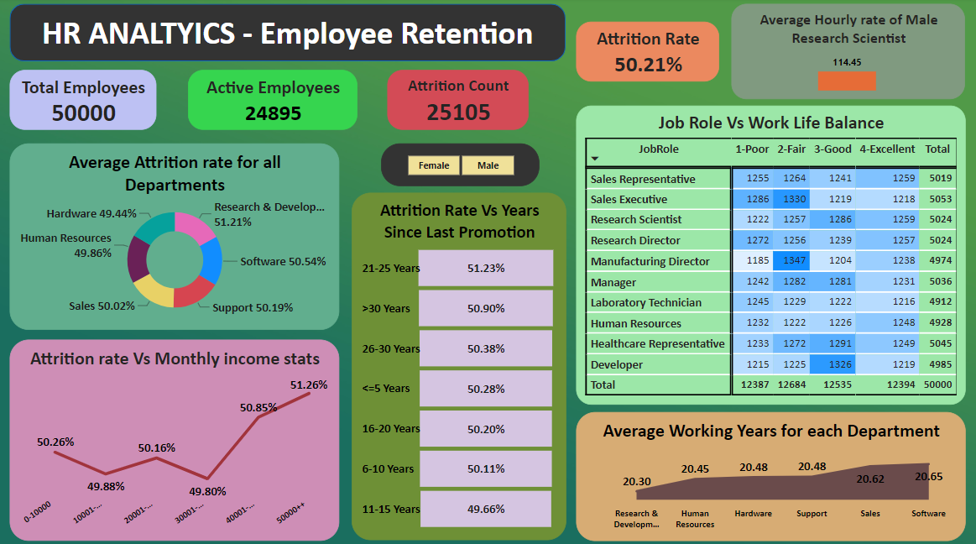

Slide 12
Conclusion :
Conduct stay interviews: Instead of exit interviews, conduct stay interviews with employees to gather feedback about the job.
Improve employee engagement: Implement initiatives to improve employee engagement, such as regular feedback, recognition and rewards programs, and opportunities for career growth.
Address workload issues: Ensure employees have manageable workloads by regularly monitoring and adjusting workloads to prevent burnout and overwhelm.
Create a positive work environment: Foster a positive work environment by promoting a culture of respect, inclusivity, and teamwork. Encourage open communication and collaboration among employees.
Address pay and compensation issues: Ensure that employees receive fair pay and compensation for their work and to find out what motivates an employee to continue to work in an organization.

